Slide 1
The Snake game
Mini project by-
Shashwat Jaiswal
IT- C
2019B131206

Slide 2



Languages used

Slide 3
Concepts
To reinforce many of the Html , CSS and Javascript programming concepts we have already met.
To provide valuable experience of the design and implementation of a larger program.

Slide 4
Introduction
The following is an example game written in html based on the game called 'snake' which has been around since the earliest days of home computing and has re-emerged in recent years on mobile phones.
It isn't the world's greatest game, but it does give us an idea of what you can achieve with a relatively simple program, and perhaps the basis by which to extend the principles and create more interesting games of your own.

Slide 5
Description
This Project of Snake Game is a simple console application with very simple graphics. In this project, you can play the popular “Snake Game" just like you played it elsewhere, You have to use the up, down, right or left arrows to move the snake.
The aim of the game is to collect food and avoid the obstacles, i.e,borders and the snake itself.

Slide 6
Foods are provided at the several co-ordinates of the screen for thesnake to eat. Every time the snake eats the food, its length will byincreased by one element along with the score.
As you collect food, the snake gets longer, so increasing your likelihood of crashing into yourself.
There is no concept of lives so once you get hit it’s game over

Slide 7
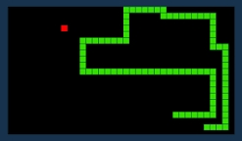
Basic outline

Slide 8
References
www.youtube.com
www.w3schools.com
www.w3.org

Slide 9
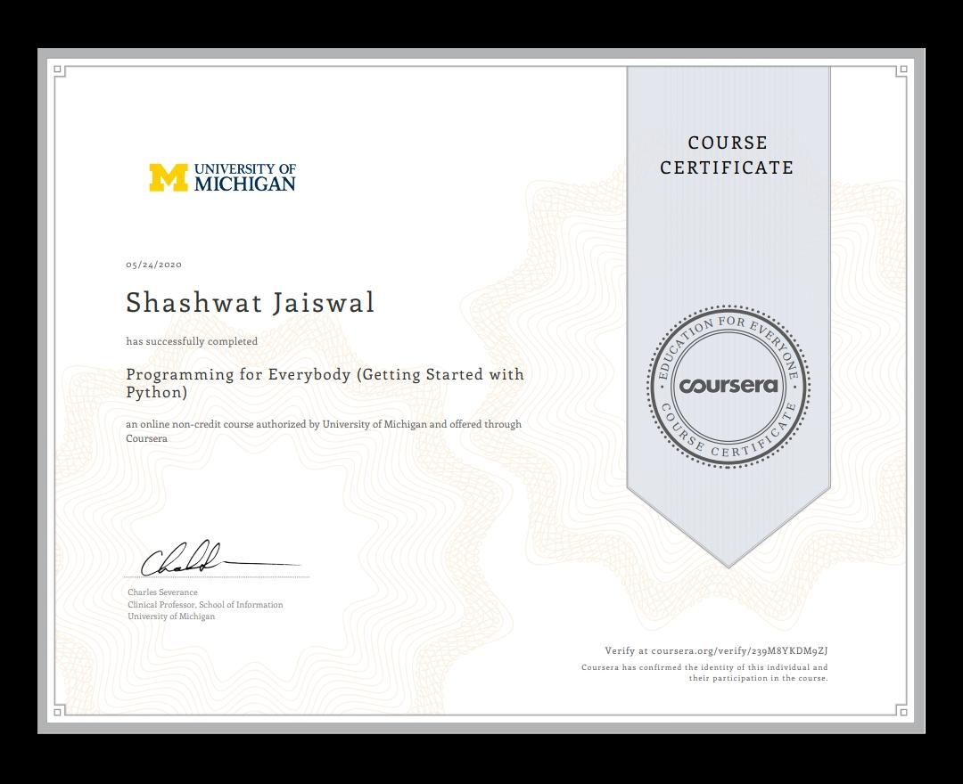
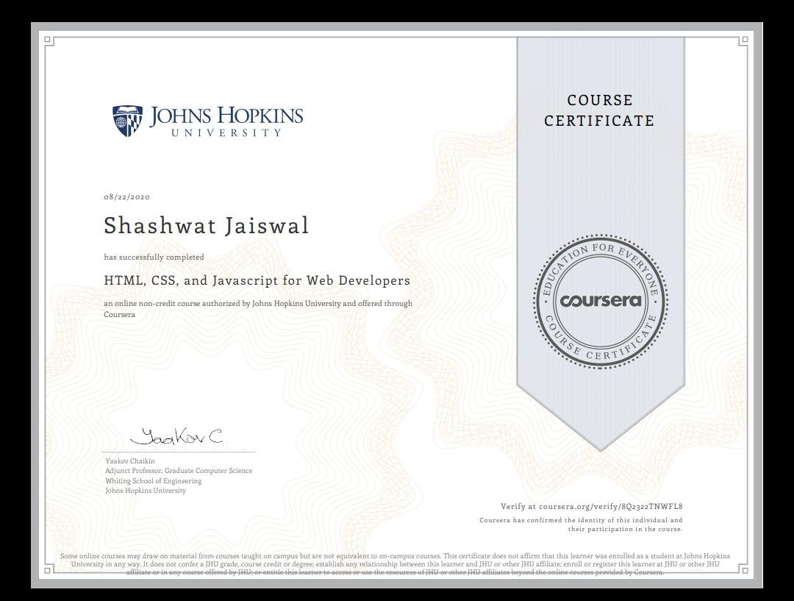
Certificates

Slide 10
!!THANK YOU!!

